Slide 1

MermaidJS Plugin

Slide 2
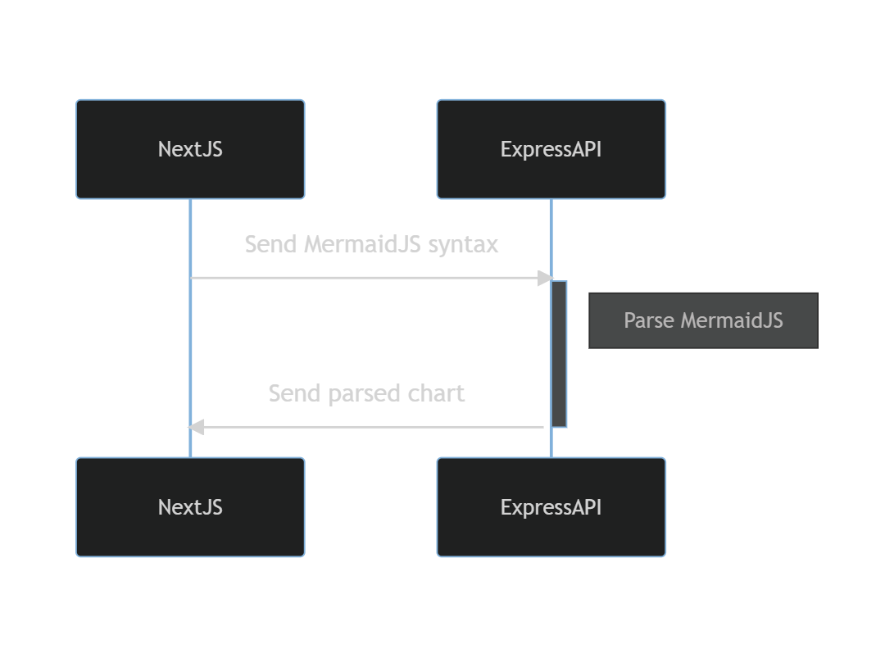
My App

Slide 3
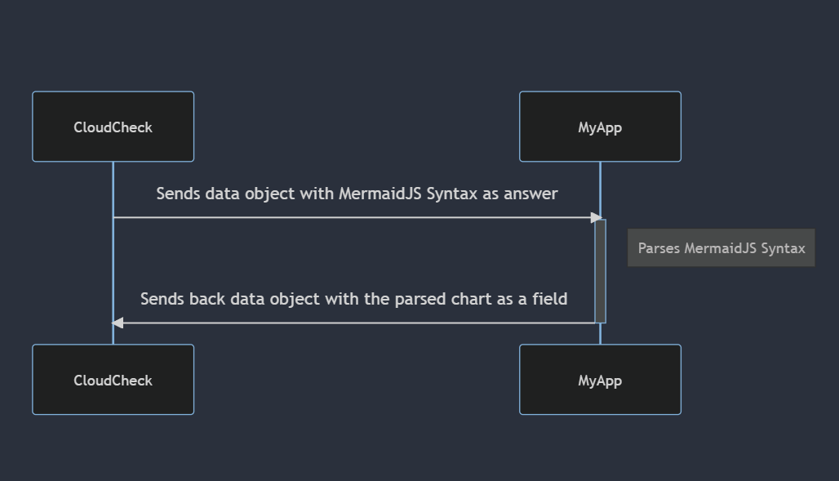

Slide 4
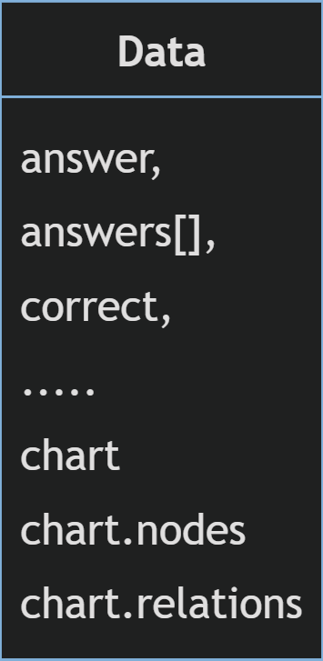
Data Object
Realistically, all you need to parse any diagram in a natural language is the nodes ( edges, classes, etc ), the relations between them ( straight-line, dotted, inheritance, composition, etc…) and the graph type.

Slide 5
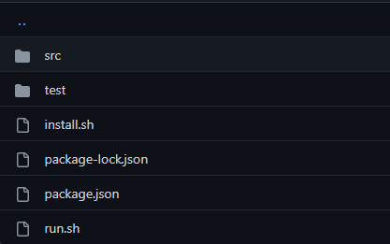
My App with CloudCheck

